Slide 1
PHI Scrub Time Study
The Ask
We need your help comparing how long it takes to scrub PHI using our current tools vs. Assima.
The Process
Stage 1: Time how long it takes to scrub a provided screenshot using current tools
Stage 2: Time how long it takes to scrub the same screen within Assima (to be completed at future date following Assima training)
Instructions
Scrub PHI on provided screenshot
Replace PHI with provided info
Make look as realistic as possible, no blurring of PHI
Time how long it takes you to complete the activity
When complete, take the completion survey to submit screenshot and time

Slide 2
Replacement Info
Name | Thomas Shelby
Humana ID Medical | H11223344
Humana ID Dental | 191919191
SSN | 555667777
Medicare ID | 1PB3G2VWXYZ
DOB | 03/12/1945
Address | 1234 Garrison Street Birmingham, MI 48012
Phone | 248-555-7182
Email | To remove

Slide 3
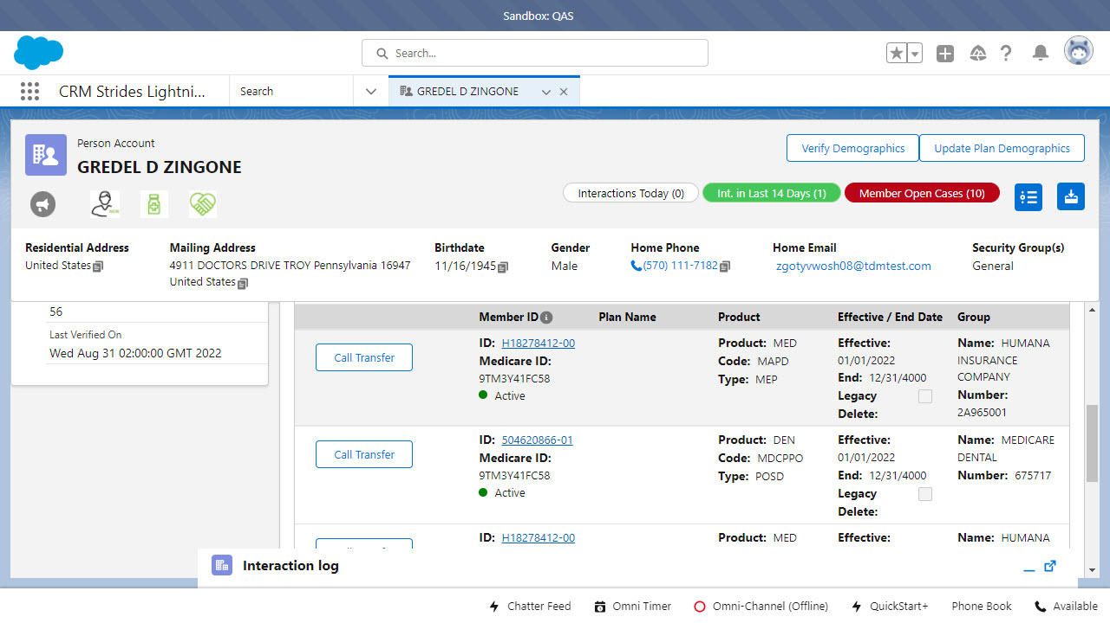
Screenshot

